Slide 1
Stack Data Structure
Prepared by: Afaq Mansoor Khan
BSSE III- Group A
Session 2017-21
IMSciences, Peshawar.

Slide 2
Last Lecture Summary
Introduction to Double Linked List
Insertions and Deletions in Doubly Linked List
Introduction to Circular Linked List
Insertion and Deletion in Circular Linked List

Slide 3
Objectives Overview
Introduction to Stack Data Structure
Stack Operations
Applications of Stack Data Structure in Computer Science

Slide 4
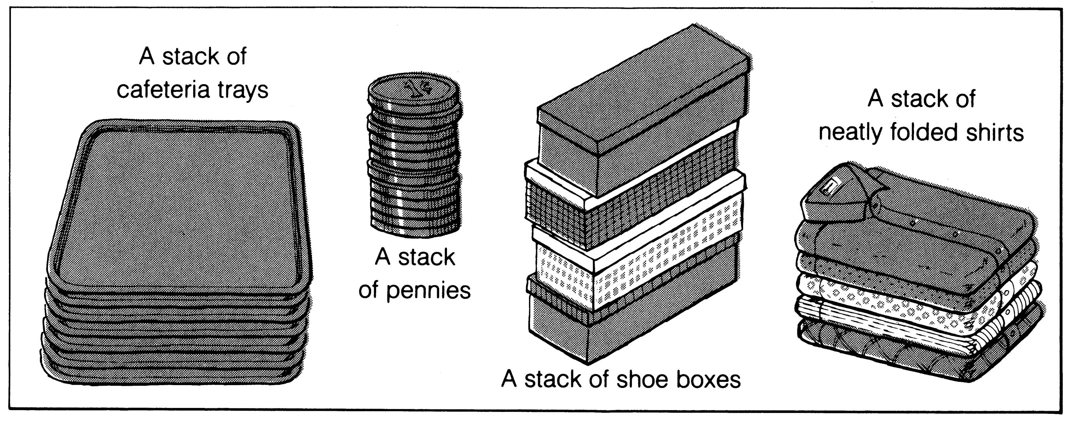
What is a stack?
It is an ordered group of homogeneous items of elements.
Elements are added to and removed from the top of the stack (the most recently added items are at the top of the stack).
The last element to be added is the first to be removed (LIFO: Last In, First Out).

Slide 5
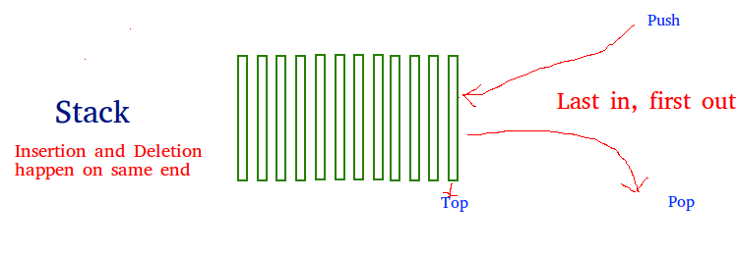

Slide 6
Stack Specification
Definitions: (provided by the user)
MAX_ITEMS: Max number of items that might be on the stack
ItemType: Data type of the items on the stack
Operations
MakeEmpty
Boolean IsEmpty
Boolean IsFull
Push (ItemType newItem)
Pop (ItemType& item)

Slide 7
Push Operation
Function: Adds newItem to the top of the stack.
Preconditions: Stack has been initialized and is not full.
Post conditions: newItem is at the top of the stack.
void StackType::Push(ItemType newItem)
{
top++;
items[top] = newItem;
}

Slide 8
Algorithm for PUSH operation
Check if the stack is full or not.
If the stack is full, then print error of overflow and exit the program.
If the stack is not full, then increment the top and add the element.

Slide 9
Pop Operation
Function: Removes topItem from stack and returns it in item.
Preconditions: Stack has been initialized and is not empty.
Post conditions: Top element has been removed from stack and item is a copy of the removed element.
void StackType::Pop(ItemType item)
{
item = items[top];
top--;
}

Slide 10
Algorithm for POP operation
Check if the stack is empty or not.
If the stack is empty, then print error of underflow and exit the program.
If the stack is not empty, then print the element at the top and decrement the top.

Slide 11
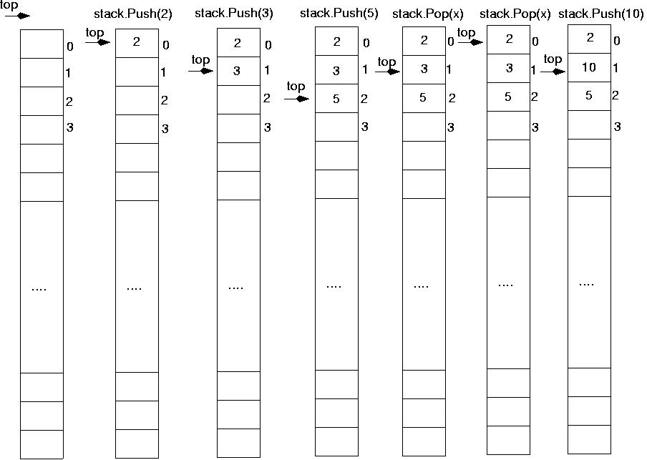

Slide 12
Stack Implementation
StackType::StackType()
{
top = -1;
}
void StackType::MakeEmpty()
{
top = -1;
}
bool StackType::IsEmpty() const
{
return (top == -1);
}

Slide 13
Stack Implementation
bool StackType::IsFull() const
{
return (top == MAX_ITEMS-1);
}
void StackType::Push(ItemType newItem)
{
top++;
items[top] = newItem;
}
void StackType::Pop(ItemType& item)
{
item = items[top];
top--;
}

Slide 14
Stack Overflow
The condition resulting from trying to push an element onto a full stack.
if(!stack.IsFull())
stack.Push(item);

Slide 15
Stack Underflow
The condition resulting from trying to pop an empty stack.
if(!stack.IsEmpty())
stack.Pop(item);

Slide 16
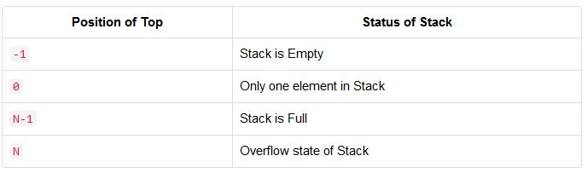
Position of Top

Slide 17
Analysis of Stack Operations
Push Operation : O(1)
Pop Operation : O(1)
Top Operation : O(1)
The time complexities for push() and pop() functions are O(1) because we always have to insert or remove the data from the top of the stack, which is a one step process.

Slide 18
Applications of Stack Data Structure

Slide 19
Stack Applications
Stacks are a very common data structure
compilers
parsing data between delimiters (brackets)
operating systems
program stack
virtual machines
manipulating numbers
pop 2 numbers off stack, do work (such as add)
push result back on stack and repeat
artificial intelligence
finding a path

Slide 20
Postfix expressions
Postfix notation is another way of writing arithmetic expressions.
In postfix notation, the operator is written after the two operands.
infix: 2+5 postfix: 2 5 +
Expressions are evaluated from left to right.
Precedence rules and parentheses are never needed!!

Slide 21
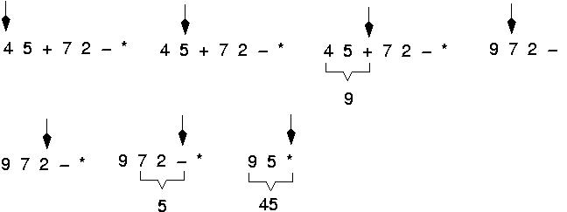
Postfix expressions

Slide 22
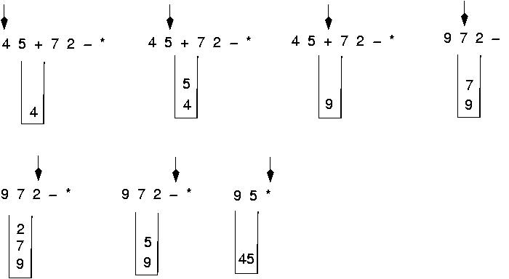
Postfix expressions: Algorithm using stacks

Slide 23
Postfix expressions: Algorithm using stacks
WHILE more input items exist
Get an item
IF item is an operand
stack.Push(item)
ELSE
stack.Pop(operand2)
stack.Pop(operand1)
Compute result
stack.Push(result)
stack.Pop(result)

Slide 24
Reverse Polish Notation
Way of inputting numbers to a calculator
(5 + 3) * 6 becomes 5 3 + 6 *
5 + 3 * 6 becomes 5 3 6 * +
We can use a stack to implement this
consider 5 3 + 6 *
+
6
*
3
6
5
8
8
48
try doing 5 3 6 * +

Slide 25
Finding a Path
Consider the following graph of flights
Z
Key
: city (represented as C)
: flight from city C₁ to city C₂
Y
C₁ C₂
W
S
R
P
T
Example
flight goes from W to S
W
S
X
Q

Slide 26
Finding a Path
If it exists, we can find a path from any city C₁ to another city C₂ using a stack
place the starting city on the bottom of the stack
mark it as visited
pick any arbitrary arrow out of the city
city cannot be marked as visited
place that city on the stack
also mark it as visited
if that’s the destination, we’re done
otherwise, pick an arrow out of the city currently at
next city must not have been visited before
if there are no legitimate arrows out, pop it off the stack and go back to the previous city
repeat this process until the destination is found or all the cities have been visited

Slide 27
Example
Want to go from P to Y
push P on the stack and mark it as visited
pick R as the next city to visit (random select)
push it on the stack and mark it as visited
pick X as the next city to visit (only choice)
push it on the stack and mark it as visited
no available arrows out of X – pop it
no more available arrows from R – pop it
pick W as next city to visit (only choice left)
push it on the stack and mark it as visited
pick Y as next city to visit (random select)
this is the destination – all done

Slide 28
Pseudo-Code for the Example
public boolean findPath(City origin, City destination) {
StackArray stack = new Stack(numCities);
clearAllCityMarks();
stack.push(origin);
origin.mark();
while(!stack.isEmpty()) {
City next = pickCity();
if(next == destination) { return true; }
if(next != null) { stack.push(next); }
else { stack.pop(); } // no valid arrows out of city
}
return false;
}

Slide 29
Summary
Introduction to Stack Data Structure
Stack Operations
Analysis of Stack Operations
Applications of Stack Data Structure in Computer Science

Slide 30
References
https://www.geeksforgeeks.org/stack-data-structure/
https://www.cse.unr.edu/~bebis/CS308/PowerPoint/Stacks.ppt
pages.cs.wisc.edu/~mattmcc/cs367/notes/Stacks.ppt
https://www.studytonight.com/data-structures/stack-data-structure
https://www.tutorialspoint.com/data_structures_algorithms/stack_algorithm.htm

